Slide 1
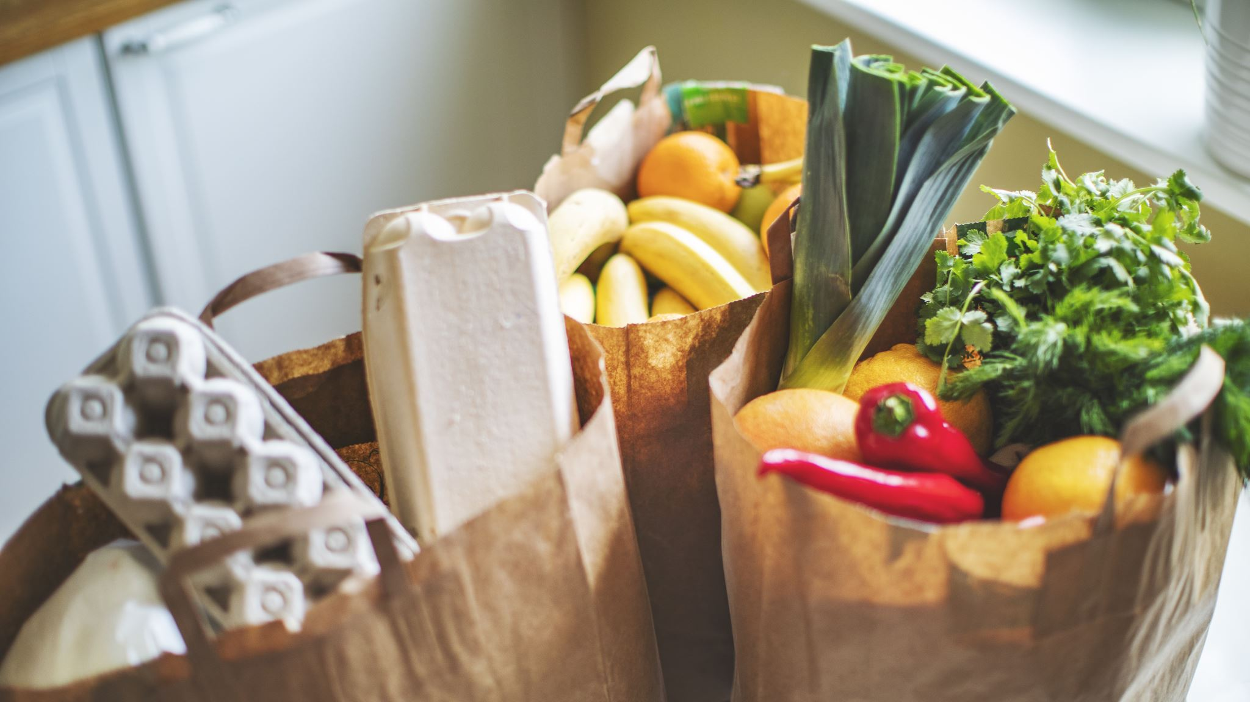
TEAM-D GROCERY STORE

Slide 2
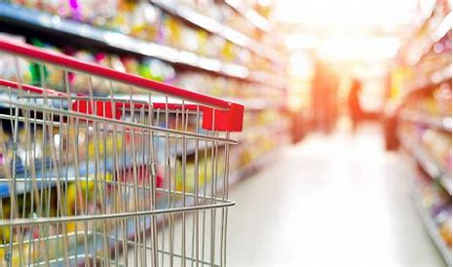
TEAM MEMBERS
Vilas Venugopal
Raghavendra Havaldar
Dinesh Varma
Manjunath Ravi
Sanjay Srikanth

Slide 3

AGENDA
Introduction
Business requirements
Problem Statement
Objectives
Implementation
Architecture
Tools
Screenshots

Slide 4
INTRODUCTION
Grocery list application, it's an ecommerce shopping app, which helps the users to shop the groceries online.
Online grocery shopping is a way of buying food and other household necessities using a web-based shopping service.

Slide 5
BUSINESS REQUIREMENTS
Users should be able to Login or Sign-Up through login or sign-up page.
Users can be able to add, delete a product from the cart.
Admin should be able to add, update or delete(CRUD Operations) and retrieve a product from the list.

Slide 6
PROBLEM STATEMENT
Grocery stores or Super-markets are too rush and customers do not bare to stand in the queue for a long time. So, the client decided to have a grocery app to sell his products which will provide benefit to him as well as for the customers too ,by saving their time from standing in the long queues for an hours together at the super-markets , Big-Bazaar etc.

Slide 7
OBJECTIVES
The main objective or goal is to provide an application which is user- friendly, where the user can buy his products and get his products with good quality and in a proper quantity at his/her door step.
The client will earn high profit by selling the products to the customer i.e., increase in customer's repeat purchase will directly increase the rate of profit for the client.

Slide 8
OPERATION OF ADMIN
ADMIN
Can add Grocery
Can delete Unavailable item from Grocery list
Can update a Grocery list

Slide 9
OPERATION OF USER
USER
Sign-Up or Login
HOME
List of Categories
Add a Product to Cart
Buy a Product
Payment

Slide 10
Architecture
Admin
products
ADD
update
delete
Vegetables
Fruits
Dashboard
Groceries
Moves to
cart
User
Meat
Payment
Daily needs
My Orders
Order Successful

Slide 11
TOOLS
Java/Java Spring Boot
MySQL
Maven
Git

Slide 12
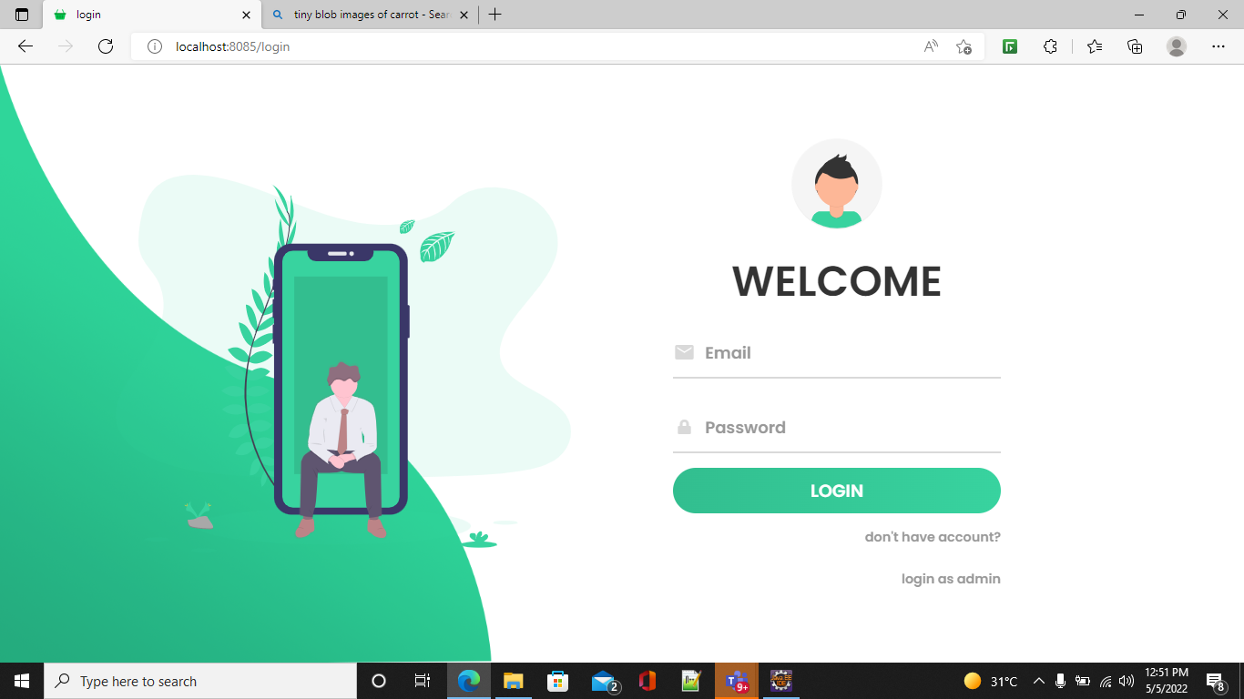
RESULTS

Slide 13
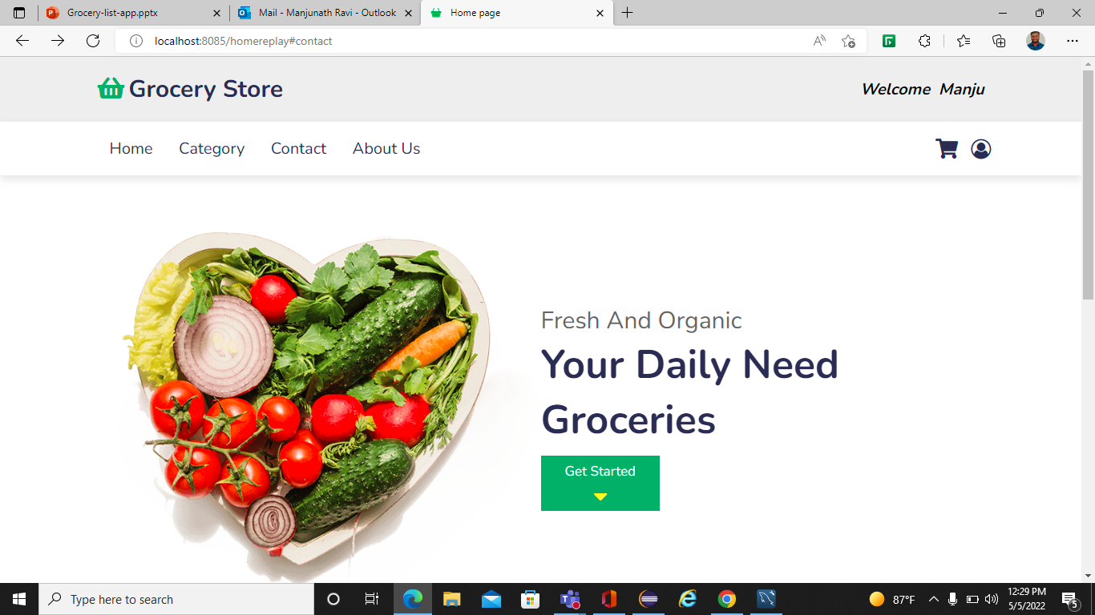
RESULTS

Slide 14
FUTURE IMPLEMENTATIONS
We are hoping to implement Delivery Status (i.e., Ordered, Out for delivery, Delivered).So, that the customer is notified about the delivery of his/her grocery.
Details (like contact) of Delivery Agent.
And, in future we are planning to implement the forgot password functionality ,so, that the user can change his/her account password if it is lost or not remembered while logging into the website.

Slide 15
THANK YOU

